Slide 1
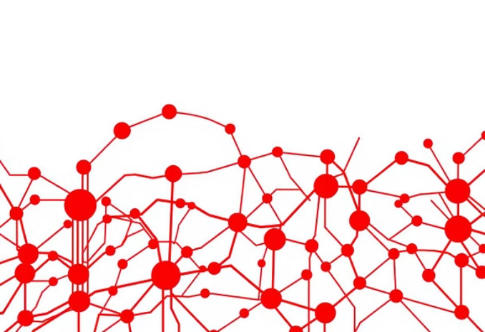

Hybrid Phishing URL Detection System
AI-Powered Defense Against Cyber Threats
Student Investigator
Shehryar Khan (Reg. No: 23108237)
Department of Robotics & Artificial Intelligence
SZABIST University, Islamabad

Slide 2

The Persistent Threat: Phishing in the Digital Age
Global Cyber Menace
Tactics of Deception
Failure of Legacy Systems
Attackers expertly mimic trusted websites, emails, and services to steal sensitive data, including login credentials and proprietary information.
Phishing remains one of the most pervasive and financially damaging cyber threats worldwide, targeting individuals and enterprises indiscriminately.
Traditional, static rule-based detection systems struggle to identify new, zero-day, or highly obfuscated URLs used in modern campaigns.
Recent Trends
Reported statistics indicate that approximately 80% of all security breaches originate with a successful phishing attack.

Slide 3

Research Motivation and Strategic Goals
Our project addresses the need for adaptive and highly accurate URL detection by moving beyond static detection methods.
Enhanced Adaptability
Superior Accuracy
Real-Time Operation
Develop a system that can quickly learn and adapt to novel phishing techniques and dynamic attacker obfuscation.
Achieve state-of-the-art precision and recall metrics, significantly improving overall detection performance.
Ensure detection operates near real-time to facilitate integration into high-volume traffic inspection systems.
Goal: Construct an intelligent hybrid model combining robust, rule-based logic with a deep Artificial Neural Network (ANN) to achieve low false positives and high precision.

Slide 4

System Architecture: An Overview
The Hybrid Detection System is structured around three core, interconnected modules that manage data processing, analysis, and interpretation.
Feature Extraction
Hybrid Detection
Visualization
1
2
3
Feature Extraction
Hybrid Detection Engine
Visualization Interface
Capturing essential lexical, host-based, and content-based traits from the input URL for analysis.
The core decision layer, fusing weighted results from the heuristic and Neural Network modules.
Providing interpretability via interactive radar and gauge charts, making results accessible.

Slide 5
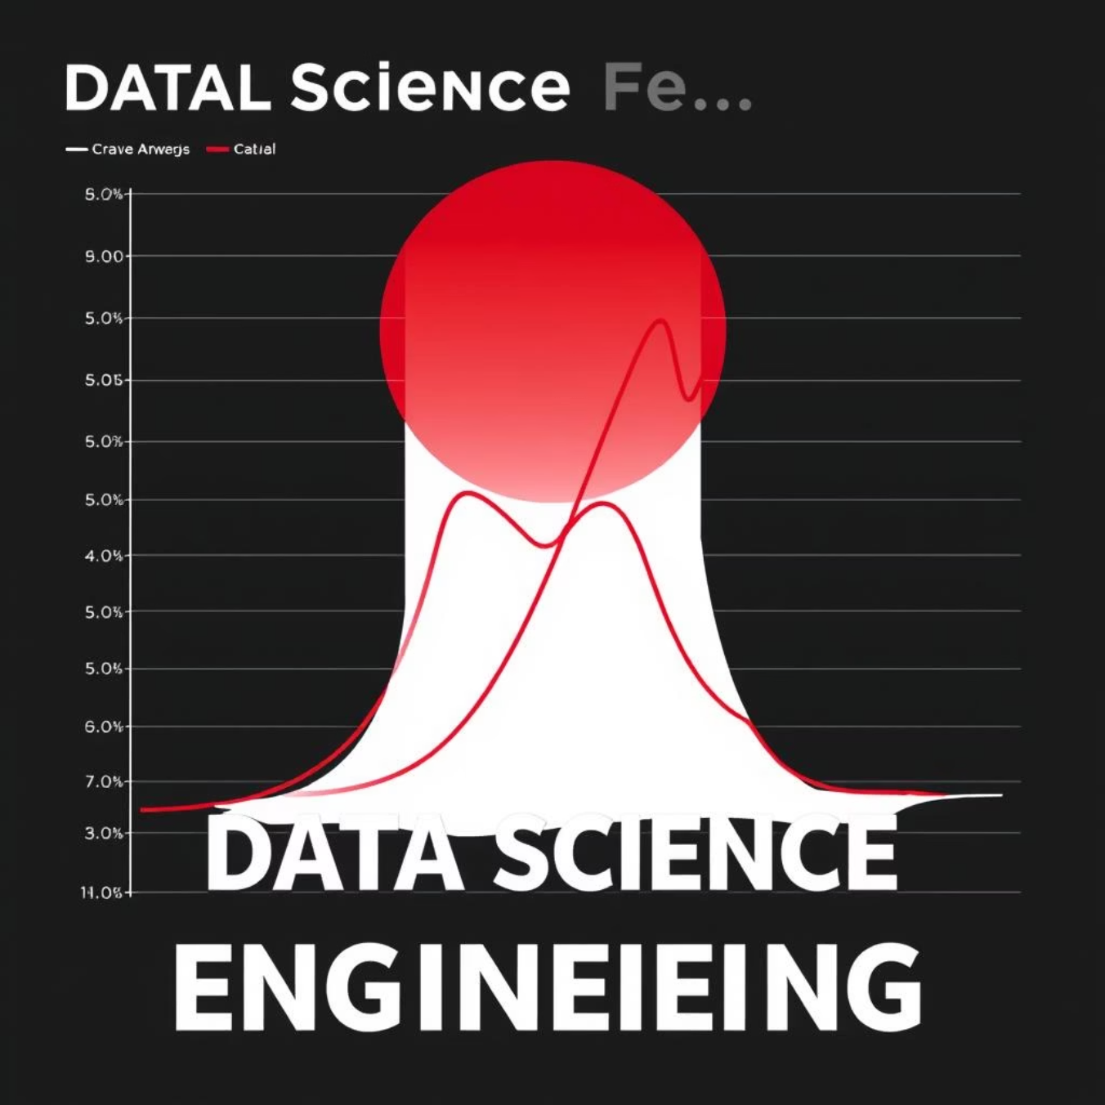
Data Acquisition and Feature Engineering
Robust feature engineering is paramount for effective hybrid model training and performance.
1
2
Curated Datasets
Feature Set Definition
Approximately 3,000 URLs were collected and balanced between verified phishing instances and legitimate web addresses from sources like PhishTank and Kaggle.
We extracted over 27 distinct features, meticulously categorised into three types for comprehensive analysis.
Lexical (e.g., URL length, entropy)
Host-based (e.g., SSL validity, registration age)
Content-based (e.g., embedded keywords like "login" or "verify")
3
Preprocessing Pipeline
Data underwent stringent cleaning, normalization, and tokenization to prepare the features for optimal model consumption and training.

Slide 6
Hybrid Detection Model Design
The strength of our approach lies in the synergistic combination of two distinct detection methodologies.
Rule-Based Module (Heuristics)
Responsible for detecting explicit, known phishing signatures and indicators based on predefined rules and expert knowledge.
Checks for high-risk IP addresses
Identifies suspicious subdomain patterns
Scores based on known deceptive keywords
Artificial Neural Network (ANN)
A 4-layer feedforward network trained to learn subtle, non-linear relationships and hidden features indicative of new threats.
Activation: ReLU and Sigmoid
Regularization: Dropout layers applied
Optimization: Adam optimizer used for training
Fusion Mechanism: The final prediction is a weighted average of the heuristic score and the ANN probability, balancing interpretability with advanced pattern recognition.

Slide 7
Implementation Stack and Toolset
A modern, industry-standard technology stack was employed to ensure scalability, speed, and ease of deployment.
Core Languages
AI Frameworks
Python provides the foundation for data processing, feature engineering, and model training scripts.
TensorFlow and Keras were crucial for efficient design, training, and deployment of the Artificial Neural Network.
Data Manipulation
Real-Time UI
Pandas and NumPy provided robust tools for dataset handling, transformation, and numerical operations.
Gradio was selected to build an intuitive, web-based interface for live testing and demonstration of the system.
Visual Output
Deployment Strategy
Plotly was utilised for generating informative, interactive visualization charts, enhancing system interpretability.
The system is packaged to be cloud-ready and supports rapid deployment on services like Vercel or local execution.

Slide 8
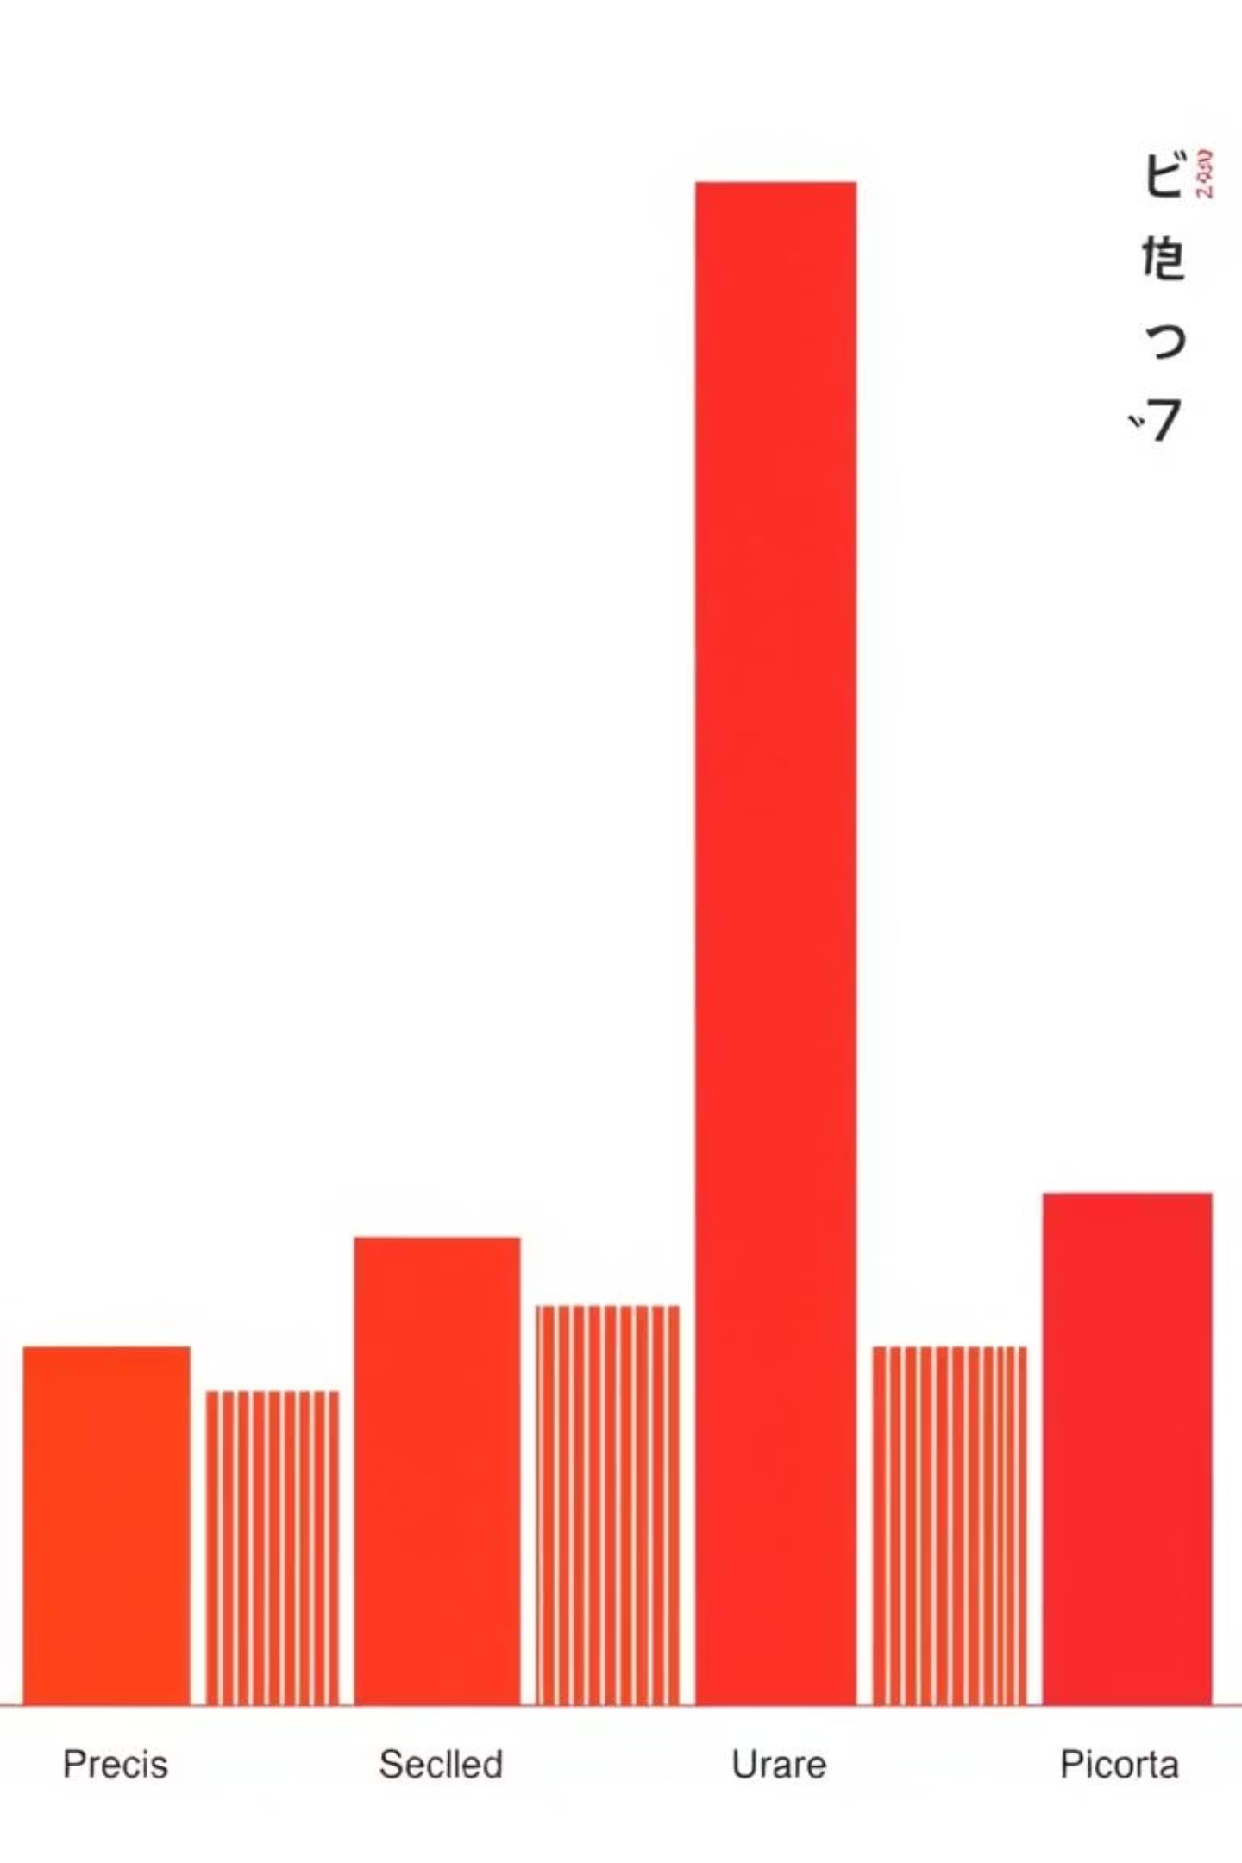
Performance Evaluation and Results
The hybrid model exhibits exceptional predictive capability, demonstrating significant improvement over individual components.
98.2%
97.8%
98.5%
Accuracy
Precision
Recall
Overall successful classification rate.
Minimising false alarms for legitimate URLs.
Identifying the majority of true phishing threats.
100ms
Detection Speed
Processing time per single URL, enabling real-time filtering.
Crucially, the hybrid fusion technique drastically reduces the rate of false positives compared to a standalone ANN, making it practical for real-world application.

Slide 9

Real-World Impact and Ethical Design
Beyond the laboratory, this research offers immediate and long-term utility while adhering to core ethical principles.
Immediate Integration
Ethical Considerations
Email Security Gateways: Filtering malicious links before they reach the user's inbox.
Privacy Preservation
Browser Plugins: Providing point-of-click threat assessment for end-users.
The system does not store or log user URLs, focusing solely on feature extraction and classification.
Enterprise APIs: Scalable threat intelligence for security operations centres (SOCs).
Research Use
The current demonstration platform is designated for educational and academic research purposes.
Transparency
The hybrid design maintains a degree of transparency absent in black-box models due to the rule-based component.

Slide 10
Conclusion and Future Directions
We have successfully developed a highly effective and reliable solution for phishing URL detection.
Balanced Design
Successfully balanced high detection speed, superior precision, and ethical AI principles within the hybrid framework.
High Efficacy
Achieved remarkable accuracy (98.2%) with a practical reduction in false positive rates.
Next Steps: Explainable AI (XAI)
Integrating XAI techniques to provide human-readable explanations for classification decisions.
Future Deployment
Developing a real-time, lightweight browser extension and establishing automated retraining pipelines.
Thank You for Your Time and Attention.
Questions are welcome. Real World Demo : https://huggingface.co/spaces/Shehryar123/Phising-app

